Slide 1
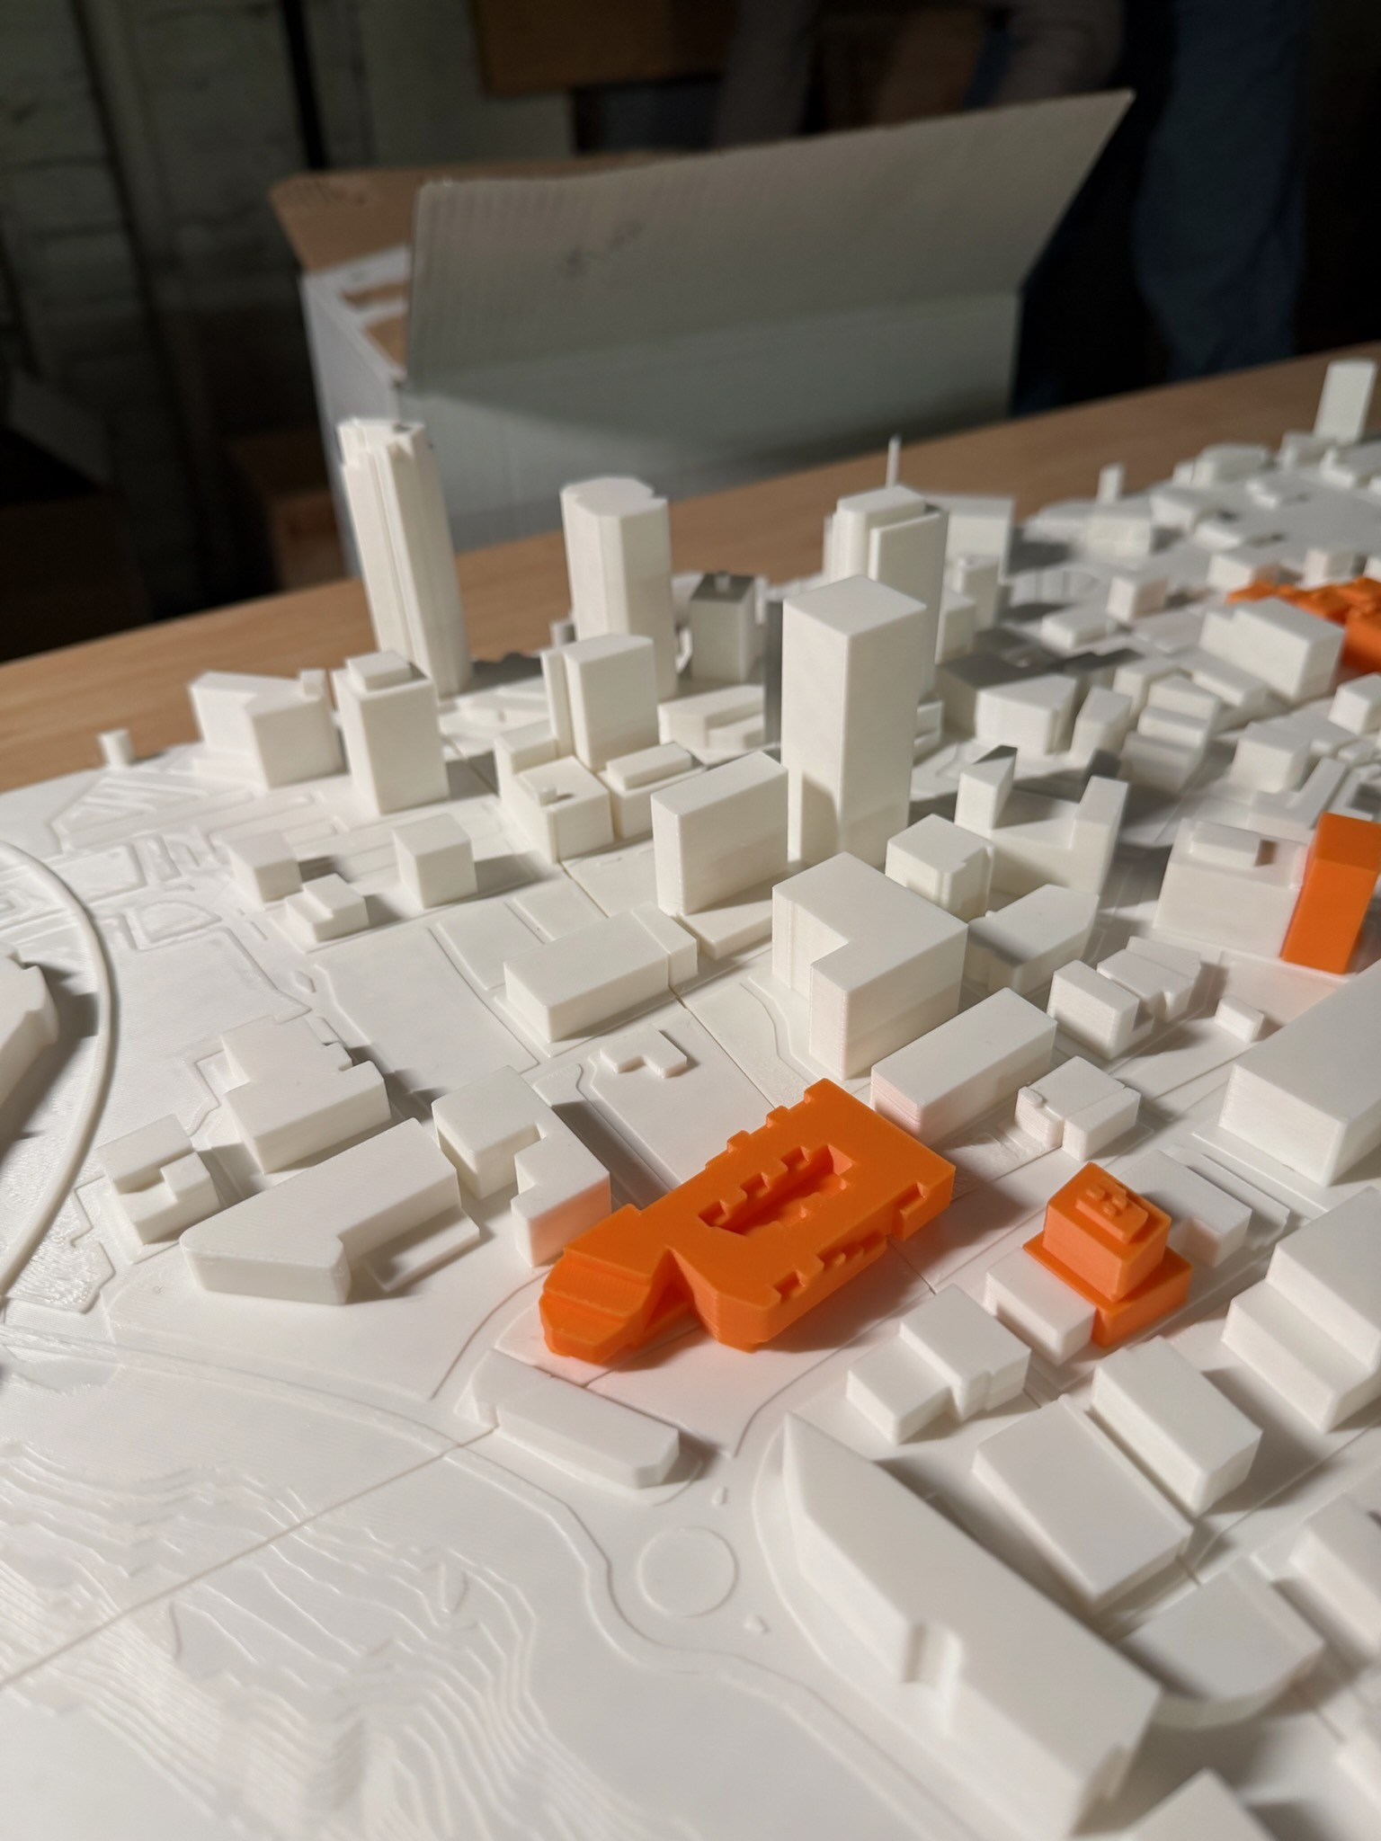
FROM PIXELS
TO PLANS
A journey into 3D architectural modelling
Gavin Koch-Schulte
MBCI Studio Program · 2025–2026

Slide 2
ABOUT GAVIN
I've always loved building things. Growing up making cities in Minecraft and Roblox, I was always drawn to how buildings look and fit together — the shapes, the detail, the way a structure can define a whole streetscape. My dad works in commercial real estate, so I grew up around real buildings — seeing blueprints, watching construction, and understanding that the things I was building digitally were real things people actually design. Studio gave me the chance to take that passion seriously.
3D printed model of downtown Winnipeg — the world Gavin wants to build in.

Slide 3
FINDING THE RIGHT TOOL
Not every tool fits every builder.
Roblox &
Minecraft
Fusion 360
Blender
Where it all started — fun, fast, and great for cities. But not what real designers use.
Tried it based on a classmate's suggestion. Better software — but slow on my computer and only a trial.
Free, powerful, and full of YouTube tutorials. Steep learning curve, but once it clicked, everything changed.
✓ CHOSEN

Slide 4
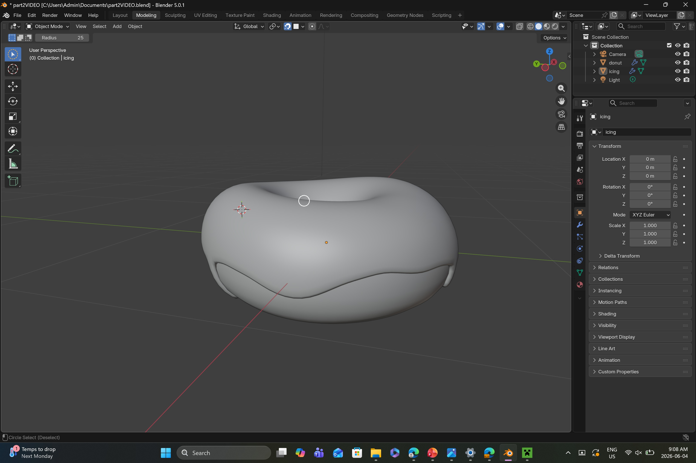
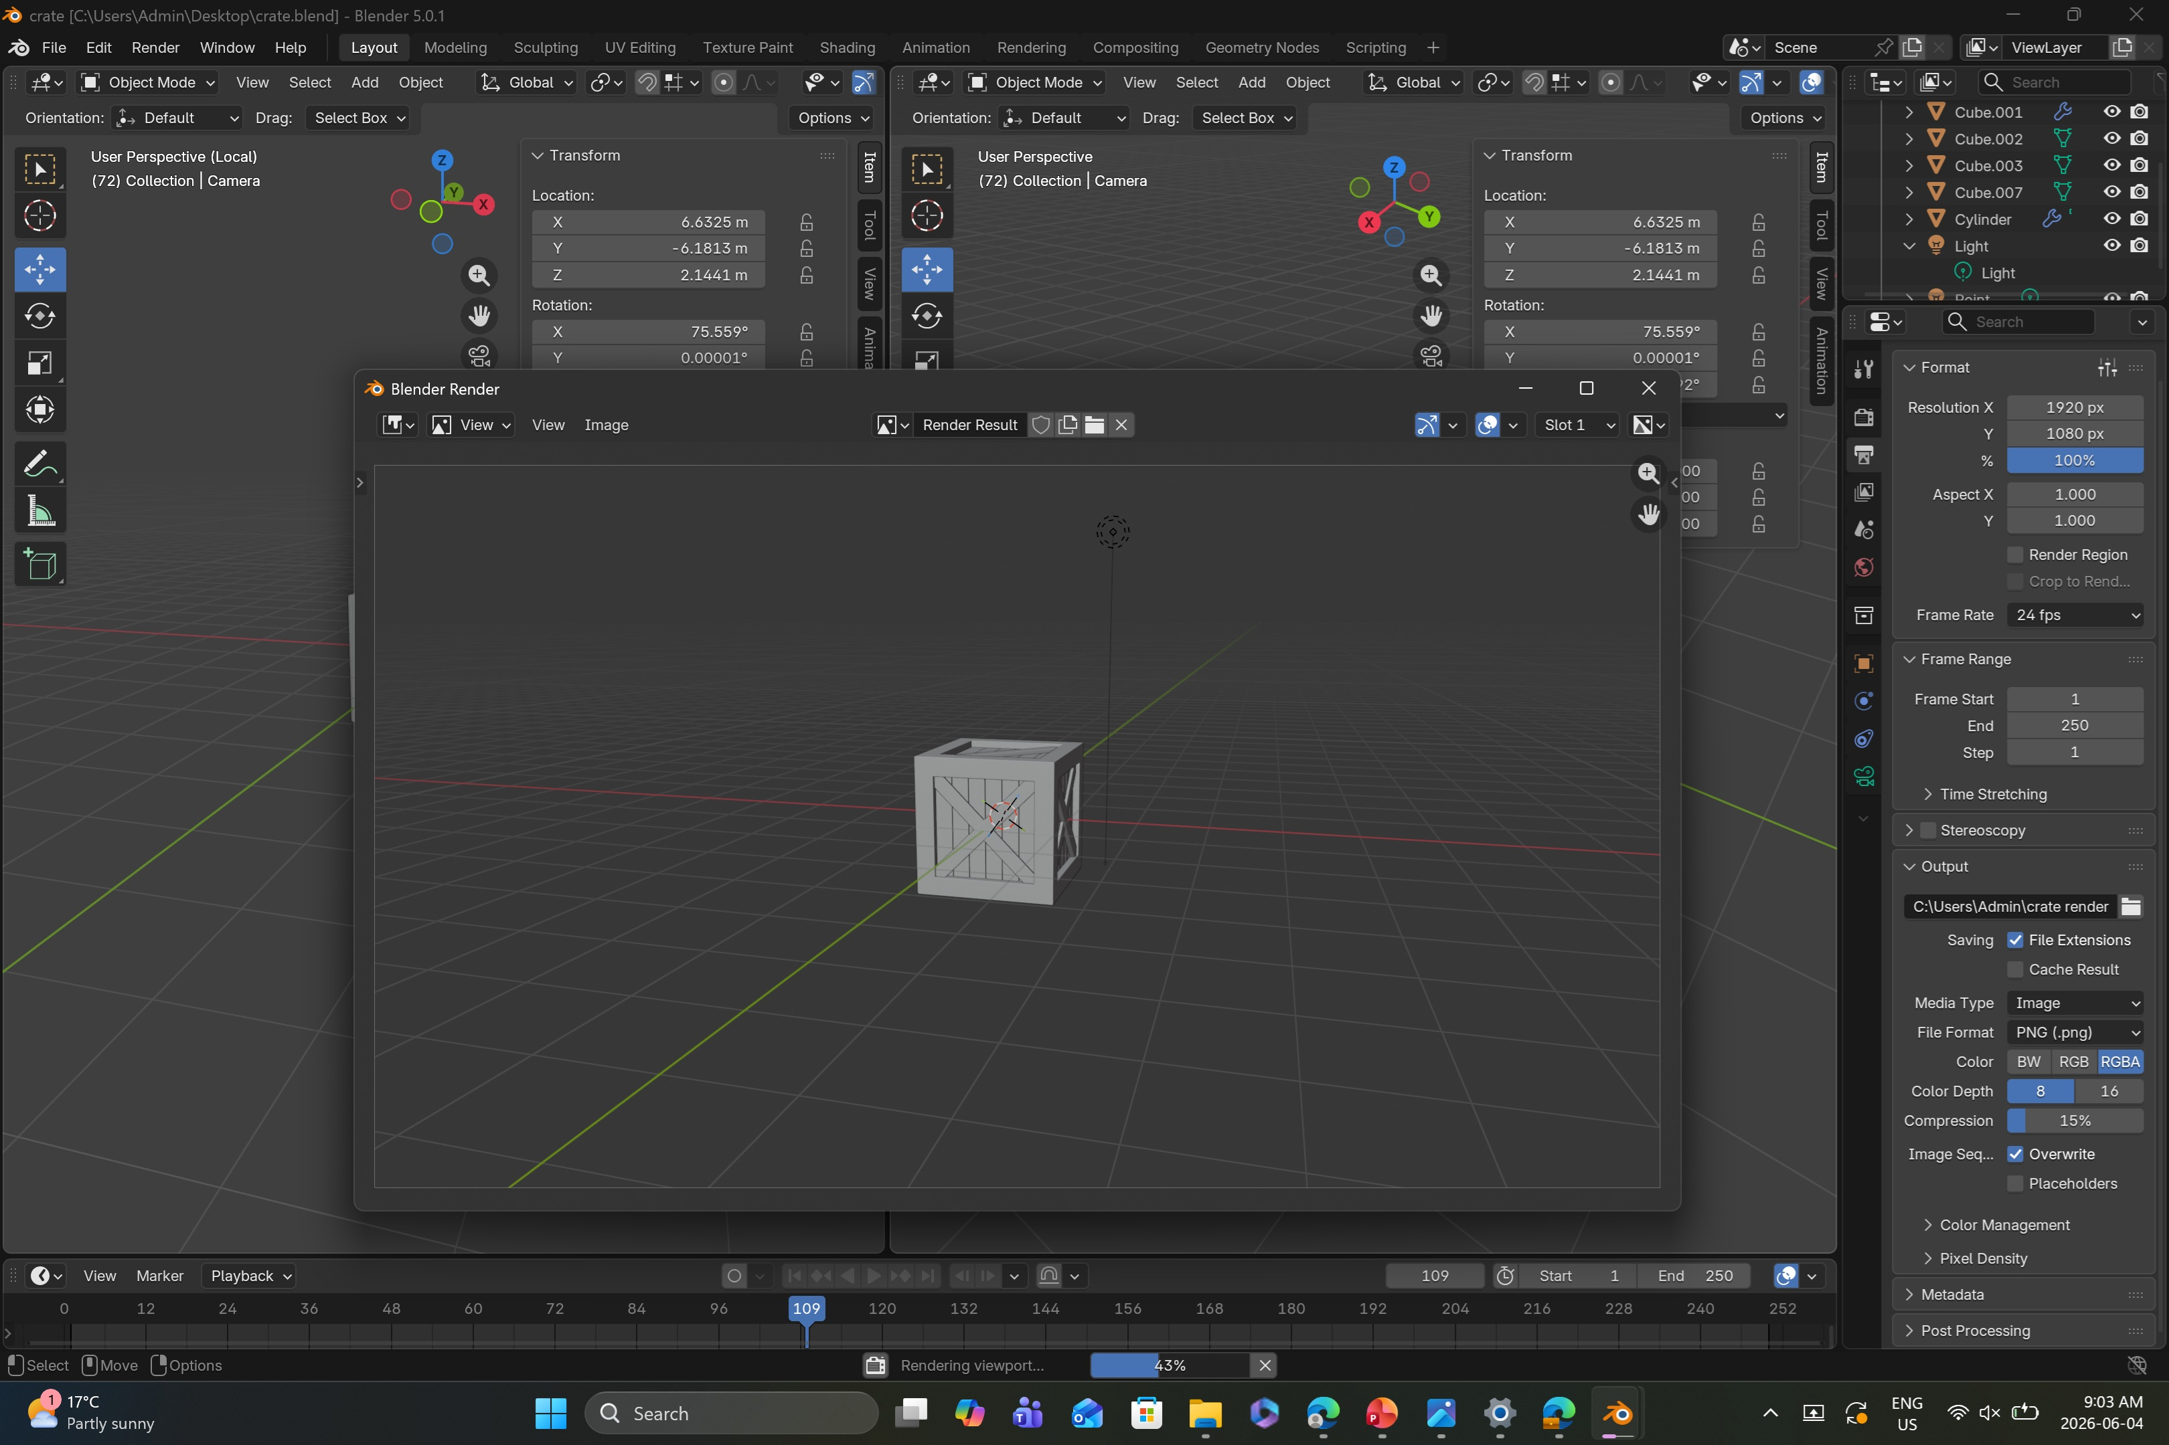
LEARNING THE BASICS
Every Blender journey starts the same way. Before building buildings, first build a donut.
Tutorial 1: The Donut
Tutorial 2: The Crate
The classic first Blender project. Teaches mesh editing, subdivision, and basic shaping — the building blocks of every model that followed.
The next step up — a hard-surface object with flat faces, edge detail, and geometry that needed to look precise. The first hint of architectural thinking.

Slide 5
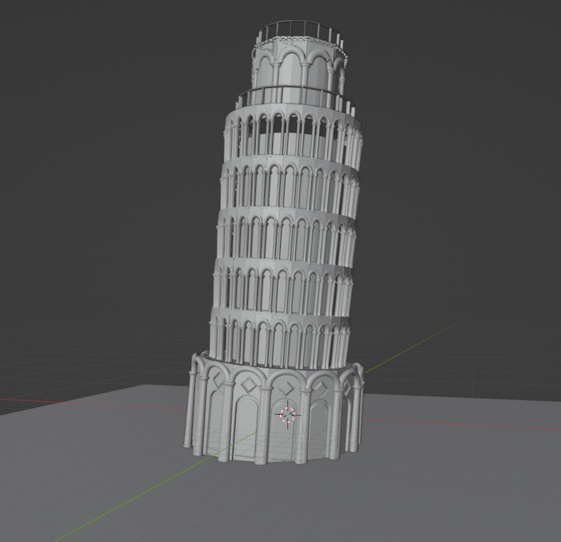
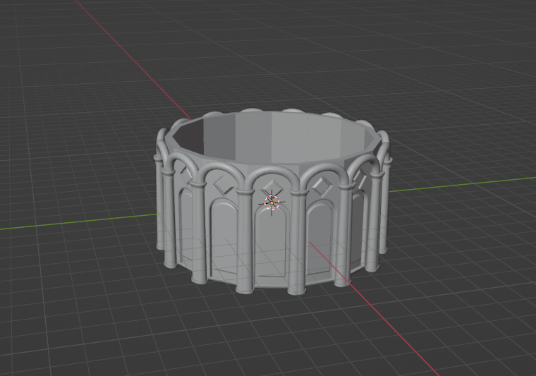
PROJECT 01
The Leaning Tower of Pisa
The first full building modelled for Studio. The Tower of Pisa was chosen deliberately — hundreds of reference photos exist online, and the circular tiered structure made it ideal for learning Blender's array and boolean tools. Each column, arch, and ring was modelled individually and repeated — a technique that would become the foundation for everything that followed.
Project 1 of 3
Early stage — individual ring sections

Slide 6
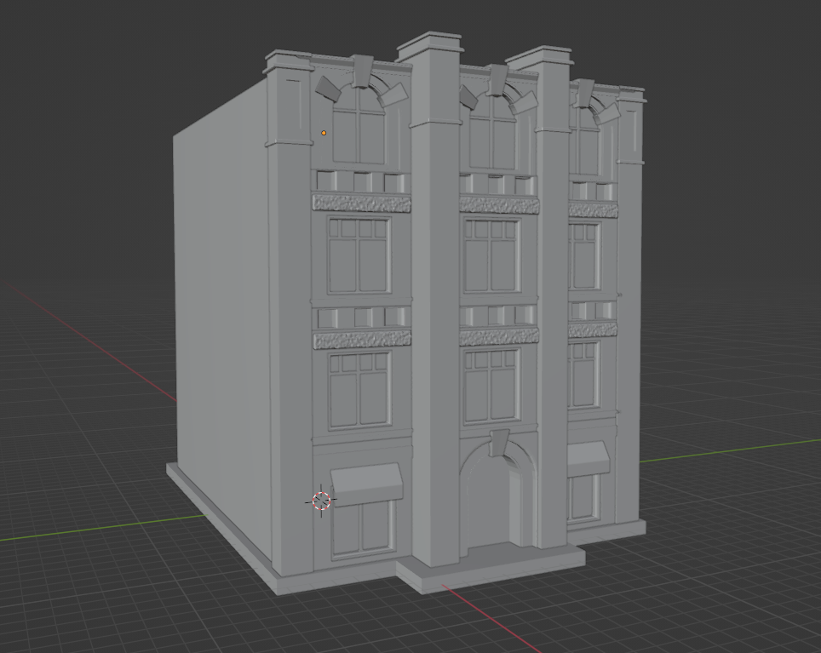
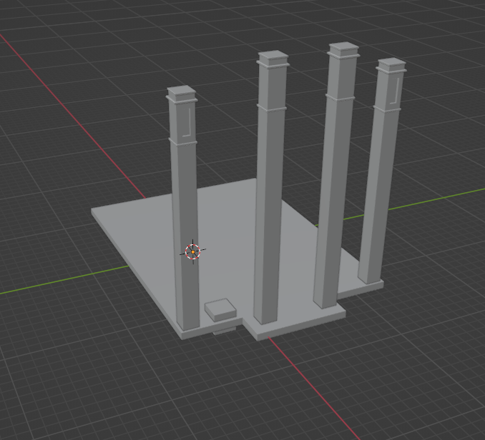
PROJECT 02
123 Bannatyne Ave, Winnipeg
Modelling a real building — from life
The next step up: a real Winnipeg building. This was a property being acquired by Gavin's father's company — which meant the stakes felt real. Every window bay, decorative column, and brick bump-out was a detail that could be checked against the actual building. "Every time I thought I was done, I would look at the real building and find something I missed." This project taught precision — and the discipline to keep going back.
Building details modelled in stages

Slide 7
THE FINAL PROJECT — PHASE 1
Meeting the Architect
For the final project, Gavin wanted to do what real architects do — design a building from scratch. Working from an actual parking lot that his father's company plans to develop, he sat down with Sean at AtLrg Architects — a professional who walked him through the real constraints any architect must work within before a single line is drawn. "I thought design was mostly about what the building looks like. I had no idea how much is decided before you even get to that."
Underground utilities
City service lines that cannot be built over
Topographical survey
Underground water and electrical mapping
Driveways & parking
Required access and stall counts
Building height limits
Zoning restrictions on how tall you can go
Sidewalk setbacks
Required clearance from the street

Slide 8
PROJECT 03
03
The Final Building
Designed from scratch.
Built to real-world constraints.
Coming soon.
Site analysis complete
Massing in progress
Exterior details — next

